Slide 1
Gaming Project(2.3) Documentation
[Daniel Z]

Slide 2
Database Design – purpose and requirements of end-users
Purpose: Database to keep track of sales of software
Requirements of users: Needs to be able to track individual orders as well as balance owing

Slide 3
Database Design – Relevant implications Explain any implications relevant to the database or its development. Check the implications in the list in the notes section that are relevant to the database that you have explained. Insert additional slides as required.
Relevant Implication | What this means… | Why this is relevant to my database…
Sustainability and Future Proofing | I need to make sure the database can easily be modified and that it minimises the use of resources | I need to make sure the outcome is constructed in a way that makes it easy to add further titles, when they are developed later. I can minimise computing resources by making field sizes no bigger than needed. I can also minimise wastage of natural resources
Notes:
Note: you should include all relevant implications you can think of. It is expected that you will include implications related to privacy/confidentiality, functionality and usability, as well as at least two other relevant implications.
These may include a selection from the following:
social and cultural
legal and ethical
intellectual property
privacy and/or confidentiality
accessibility
usability
functionality
aesthetics
sustainability and future proofing
end-user considerations
health and safety

Slide 4
Database Design – Relevant implications Explain any implications relevant to the database or its development. Check the implications in the list in the notes section that are relevant to the database that you have explained. Insert additional slides as required.
Relevant Implication | What this means… | Why this is relevant to my database…
Legal | This relates to privacy of information (Privacy act) and use of copyright (Copyright act) | Because my database will include personal and finical information about clients, it is important their privacy be protected. I need to ensure any images and text I use are provided by the customer or I am legally be able to use them.
Notes:
Note: you should include all relevant implications you can think of. It is expected that you will include implications related to privacy/confidentiality, functionality and usability, as well as at least two other relevant implications.
These may include a selection from the following:
social and cultural
legal and ethical
intellectual property
privacy and/or confidentiality
accessibility
usability
functionality
aesthetics
sustainability and future proofing
end-user considerations
health and safety

Slide 5
Database Design – Relevant implications Explain any implications relevant to the database or its development. Check the implications in the list in the notes section that are relevant to the database that you have explained. Insert additional slides as required.
Relevant Implication | What this means… | Why this is relevant to my database…
usability | The database needs to be easy to use and intuitive so that it can achieve the outcomes intended | I need to be able to present the information in a way that meets the customers needs. To do this I need to consider and understand what the customer expects. I need to thoroughly test the database to ensure accuracy and reliable information.
Notes:
Note: you should include all relevant implications you can think of. It is expected that you will include implications related to privacy/confidentiality, functionality and usability, as well as at least two other relevant implications.
These may include a selection from the following:
social and cultural
legal and ethical
intellectual property
privacy and/or confidentiality
accessibility
usability
functionality
aesthetics
sustainability and future proofing
end-user considerations
health and safety

Slide 6
Database Design – Tables Duplicate this page for each table.
Table Name:tblCustomers
Field Name | Data Type | Field Size | Format | Description
customerPK | Autonumber |  |  | PK
custFirstName | Short Text | 20
custLastName | Short Text | 20
custAdress1 | Short Text | 40
custAdress2 | Short Text
cityName | Long Integer |  |  | FK
custEmail | Short text | 30

Slide 7
Database Design – Tables Duplicate this page for each table.
Table Name:tblCity
Table Name:tblPayment
Field Name | Data Type | Field Size | Format | Description
cityPK | Autonumber |  |  | pk
cityName | Short Text | 30 |  | REquired
Field Name | Data Type | Field Size | Format | Description
paymentID | Autonumber |  |  | pk
paymentType | Short Text | 30

Slide 8
Database Design – Tables Duplicate this page for each table.
Table Name:tblOrders
Table Name:tblDeliveries
Field Name | Data Type | Field Size | Format | Description
orderID | Autonumber |  |  | PK
customerFK | Number | Long Interger
orderDate | Date/time |  | Medium
orderQuantity | Number | Byte
orderTotal | Calculated |  |  | orderQuantity*25
deliveryFK | Number | Long Integer |  | Required
paymentFK | Number | Long integer |  | Required
Field Name | Data Type | Field Size | Format | Description
orderID | Autonumber |  |  | PK
customerFK | Number | Long Interger
orderDate | Date/time |  | Medium

Slide 9
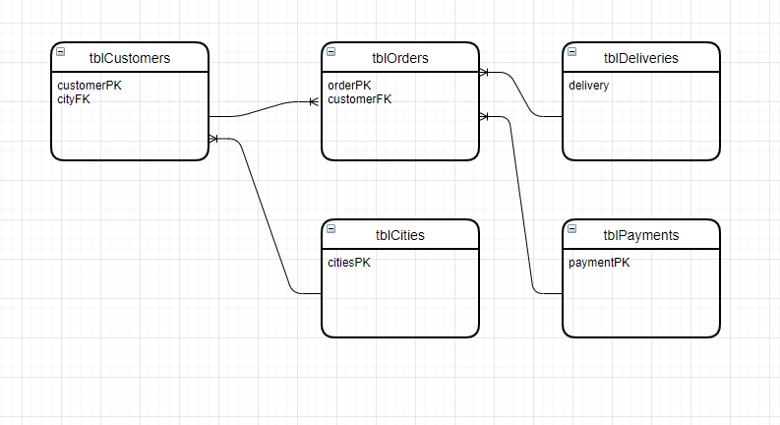
Database design – Relationships Produce a sketch showing the relationships you propose to create between your tables
Having planned my tables I then used draw.io to plan the relationships between the tables.

Slide 10
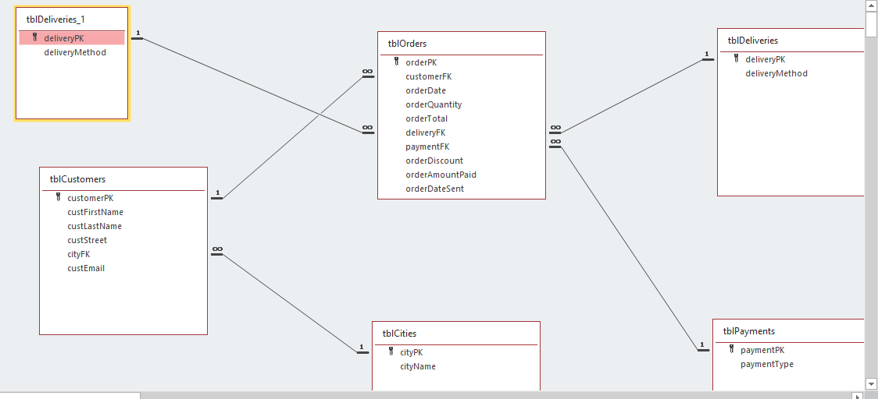
Database design – Relationships Produce a sketch showing the relationships you propose to create between your tables
I created the relationships according to my plan in Access. All tables have a one many relationship which enforces referential integrity.

Slide 11
Feedback – usability testing
Who gave you feedback? | What feedback did they give you? | How did this help improve your design?
Notes:
Get people (outside of the class) to test:
general appearance and ease of use (e.g. to enter data)
logical and attractive layout (e.g. of forms and reports)
suggestions for better meeting the end-user purpose

Slide 12


Data Integrity And Testing Create the database and then explain how have you applied data integrity (e.g. field length, data types and/or validation rules) and testing procedures? – see the notes page
I Created a query to populate the customer name field in tblOrders the most efficient way to include the name is to use the query builder on t he customerFK field. I tested to make sure it was producing the correct results by comparing the contents of the tblCustomers to the new lookup field in tblOrders and they produce the same results exactly
Notes:
Apply appropriate data integrity (e.g. field length, data types and/or validation rules) and testing procedures to the database to ensure the following: (2.3 ACHIEVED)
Data is accurately entered and stored in the database
Tables have been correctly linked (correct field links and relationship types)
Any queries, sorts, filters and/or calculated fields produce expected and accurate results
Database objects (e.g. reports) are legible and presented according to the end-user requirements
Data integrity techniques are functioning as expected
Make sure you show evidence of all the above
(2.3 MERIT)
Evidence of comprehensive testing with sample data
Use the information you gathered from testing to improve the database.
e.g. improving the quality and functionality of forms, queries and reports
(2.3 EXCELLENCE)
In addition to testing that ensures the database functions as expected, you must show how you have improved the quality of the database
through feedback and cycles of trialling and testing repeatedly throughout the design, development and testing process

Slide 13
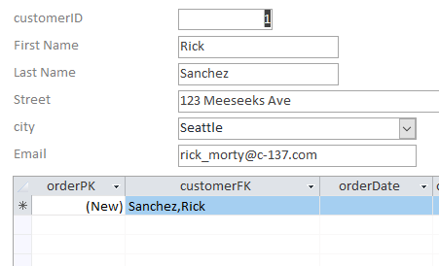
Data Integrity And Testing Create the database and then explain how have you applied data integrity (e.g. field length, data types and/or validation rules) and testing procedures? – see the notes page
I checked to make sure the link to the foreign key in the sub form matched the customer in the main form. One confirmed I deleted the customerFK from the subform as it was no longer required.
Notes:
Apply appropriate data integrity (e.g. field length, data types and/or validation rules) and testing procedures to the database to ensure the following: (2.3 ACHIEVED)
Data is accurately entered and stored in the database
Tables have been correctly linked (correct field links and relationship types)
Any queries, sorts, filters and/or calculated fields produce expected and accurate results
Database objects (e.g. reports) are legible and presented according to the end-user requirements
Data integrity techniques are functioning as expected
Make sure you show evidence of all the above
(2.3 MERIT)
Evidence of comprehensive testing with sample data
Use the information you gathered from testing to improve the database.
e.g. improving the quality and functionality of forms, queries and reports
(2.3 EXCELLENCE)
In addition to testing that ensures the database functions as expected, you must show how you have improved the quality of the database
through feedback and cycles of trialling and testing repeatedly throughout the design, development and testing process

Slide 14
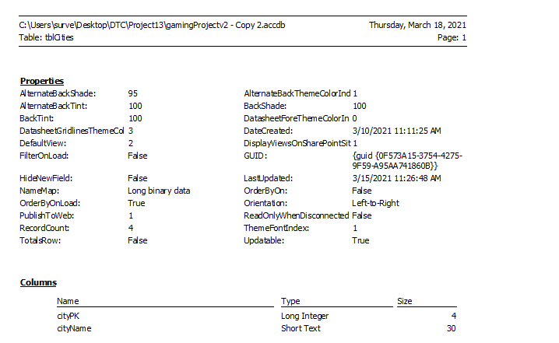
Data Integrity And Testing - tables C I used the database documenter to check that my table is set up correctly and that they matched my earlier plan
Notes:
Apply appropriate data integrity (e.g. field length, data types and/or validation rules) and testing procedures to the database to ensure the following: (2.3 ACHIEVED)
Data is accurately entered and stored in the database
Tables have been correctly linked (correct field links and relationship types)
Any queries, sorts, filters and/or calculated fields produce expected and accurate results
Database objects (e.g. reports) are legible and presented according to the end-user requirements
Data integrity techniques are functioning as expected
Make sure you show evidence of all the above
(2.3 MERIT)
Evidence of comprehensive testing with sample data
Use the information you gathered from testing to improve the database.
e.g. improving the quality and functionality of forms, queries and reports
(2.3 EXCELLENCE)
In addition to testing that ensures the database functions as expected, you must show how you have improved the quality of the database
through feedback and cycles of trialling and testing repeatedly throughout the design, development and testing process

Slide 15
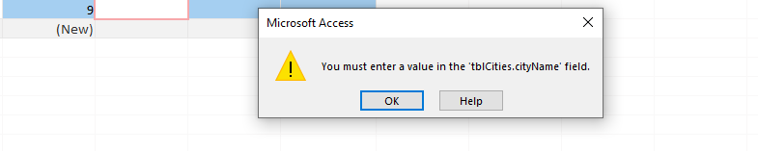
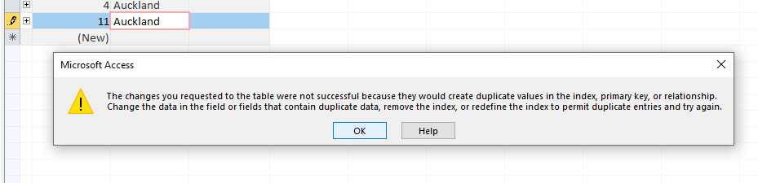
Data Integrity And Testing - tables C These are examples of the tests I conducted on all my tables to ensure they work as planned:
1. Test to ensure you cant leave a required field blank
2. Test that duplicate data cannot be entered
Notes:
Apply appropriate data integrity (e.g. field length, data types and/or validation rules) and testing procedures to the database to ensure the following: (2.3 ACHIEVED)
Data is accurately entered and stored in the database
Tables have been correctly linked (correct field links and relationship types)
Any queries, sorts, filters and/or calculated fields produce expected and accurate results
Database objects (e.g. reports) are legible and presented according to the end-user requirements
Data integrity techniques are functioning as expected
Make sure you show evidence of all the above
(2.3 MERIT)
Evidence of comprehensive testing with sample data
Use the information you gathered from testing to improve the database.
e.g. improving the quality and functionality of forms, queries and reports
(2.3 EXCELLENCE)
In addition to testing that ensures the database functions as expected, you must show how you have improved the quality of the database
through feedback and cycles of trialling and testing repeatedly throughout the design, development and testing process

Slide 16
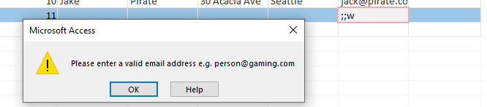
Data Integrity And Testing - tables C These are examples of the tests I conducted on all my tables to ensure they work as planned:
3. Test that input mask and validation rules work I set up a validation rule for email which requires at east one character, @, then at least one more character. Space, commas, and semi-colons are not permitted.
Is Null Or ((Like “*?@?*”) And (Not Like “*[,;:]*”))
Notes:
Apply appropriate data integrity (e.g. field length, data types and/or validation rules) and testing procedures to the database to ensure the following: (2.3 ACHIEVED)
Data is accurately entered and stored in the database
Tables have been correctly linked (correct field links and relationship types)
Any queries, sorts, filters and/or calculated fields produce expected and accurate results
Database objects (e.g. reports) are legible and presented according to the end-user requirements
Data integrity techniques are functioning as expected
Make sure you show evidence of all the above
(2.3 MERIT)
Evidence of comprehensive testing with sample data
Use the information you gathered from testing to improve the database.
e.g. improving the quality and functionality of forms, queries and reports
(2.3 EXCELLENCE)
In addition to testing that ensures the database functions as expected, you must show how you have improved the quality of the database
through feedback and cycles of trialling and testing repeatedly throughout the design, development and testing process

Slide 17
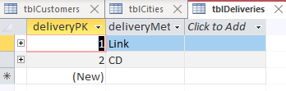


Data Integrity And Testing - tables C These are examples of the tests I conducted on all my tables to ensure they work as planned:
4. Check that the data has been entered correctly by comparing it with the original data There were 3 records in the original data and there were 3 records in my customer table. I checked that they were 3 cities and 2 payments and 2 delivery methods to ensure these were the same as the original data. I have included screen snips from the original spreadsheet and compared it to my table
Notes:
Apply appropriate data integrity (e.g. field length, data types and/or validation rules) and testing procedures to the database to ensure the following: (2.3 ACHIEVED)
Data is accurately entered and stored in the database
Tables have been correctly linked (correct field links and relationship types)
Any queries, sorts, filters and/or calculated fields produce expected and accurate results
Database objects (e.g. reports) are legible and presented according to the end-user requirements
Data integrity techniques are functioning as expected
Make sure you show evidence of all the above
(2.3 MERIT)
Evidence of comprehensive testing with sample data
Use the information you gathered from testing to improve the database.
e.g. improving the quality and functionality of forms, queries and reports
(2.3 EXCELLENCE)
In addition to testing that ensures the database functions as expected, you must show how you have improved the quality of the database
through feedback and cycles of trialling and testing repeatedly throughout the design, development and testing process

Slide 18
Address relevant implications How have you addressed the relevant implications (described earlier in this presentation) to your designs?
[Record your explanation here]
Notes:
State the implication and describe what that means in general
Explain how you addressed it
Example to demonstrate how you addressed it in your outcome
Why this matters to your audience/end users.
Need to go beyond demonstrating a simple understanding e.g., point to specific examples where the database has addressed relevant implications

Slide 19
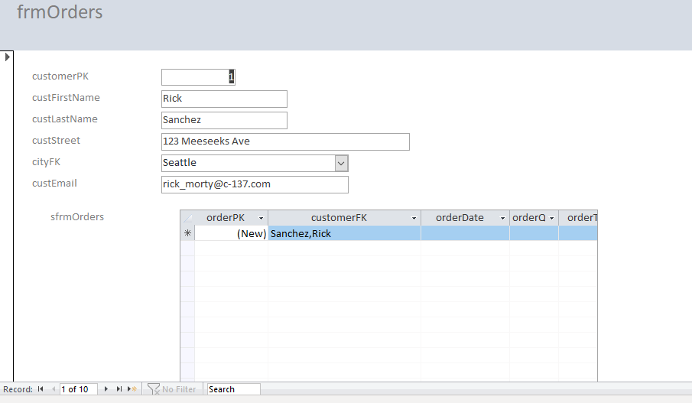
Iterative improvement (for Excellence) H I used the form wizard to create a form for entering order into my data database. The Main form is based on tblCustomers and the sub form is based on tblOrders. My initial design was not very attractive or user friendly, it also includes some fields which aren’t necessary, except for testing e.g customerFK in the subform.
Notes:
Continually improve your database throughout the process of its design, development, and testing.
You need to have evidence of (screen snips, images and notes) of all tests and improvements you made throughout the process
There is clear evidence of iterative improvement throughout the design, development, and comprehensive testing
Below are some examples:
Example 1
Enter just a few records (enough to ensure efficient testing).
Make any changes necessary.
When you are happy that all data is being stored, filtered, queried and/or calculated correctly, import or enter the reminder of the records.
Finally, check that all these records have been entered correctly.
Example 2
Get feedback from your end user(s) or others on the database and it’s ease of use to enter data (forms) as well as the way in which output is organized and presented (reports)
Use this feedback to make improvements to the database.
Ask your user(s) for further feedback once improvements have been made, etc.

Slide 20
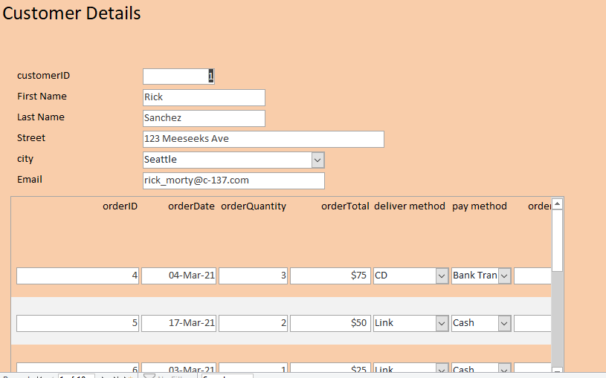
Iterative improvement (for Excellence) How have you continually improved your database throughout the process of it’s design, development and testing? You need to show evidence of your ongoing tests and improvements throughout the whole process. You need to have many examples.
Notes:
Continually improve your database throughout the process of its design, development, and testing.
You need to have evidence of (screen snips, images and notes) of all tests and improvements you made throughout the process
There is clear evidence of iterative improvement throughout the design, development, and comprehensive testing
Below are some examples:
Example 1
Enter just a few records (enough to ensure efficient testing).
Make any changes necessary.
When you are happy that all data is being stored, filtered, queried and/or calculated correctly, import or enter the reminder of the records.
Finally, check that all these records have been entered correctly.
Example 2
Get feedback from your end user(s) or others on the database and it’s ease of use to enter data (forms) as well as the way in which output is organized and presented (reports)
Use this feedback to make improvements to the database.
Ask your user(s) for further feedback once improvements have been made, etc.

